Slide 1
Customer Segmentation Using RFM Analysis
Turning transaction data into business decisions
Presented by:
Gowri Abbigeri

Slide 2
Business Problem
Customer Value & Retention Analysis using RFM
Businesses generate millions in sales — but struggle to answer:
Which customers truly drive revenue?
Which customers are about to churn?
Where is revenue actually concentrated?
Are we investing in the right customers?
📉 The Reality
Revenue is often concentrated in a small segment of customers
Churn risk goes unnoticed until revenue declines
Marketing budgets are spent without segmentation
🎯 The Objective
Use RFM (Recency, Frequency, Monetary) segmentation to:
Identify high-value customers
Detect at-risk customers early
Understand revenue distribution
Build targeted retention strategies

Slide 3
RFM Methodology
RFM is a behavioral segmentation technique based on:
Recency (1–5 scale) - Days since last purchase (Lower = better)
Frequency (1–5 scale) - Number of purchases (Higher = better)
Monetary (1–5 scale) - Total spend (Higher = better)
Customers are scored and grouped into segments:
Champions
Big Spenders
Loyal Customers
At Risk
Lost
Others

Slide 4
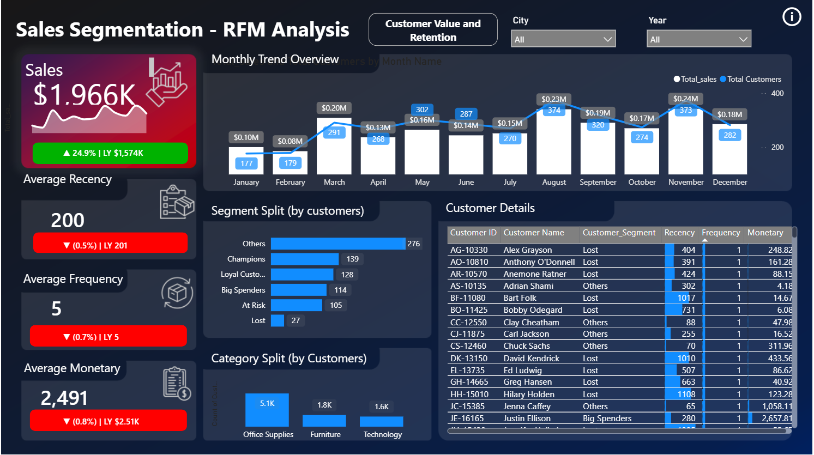
Customer Segmentation Overview

Slide 5
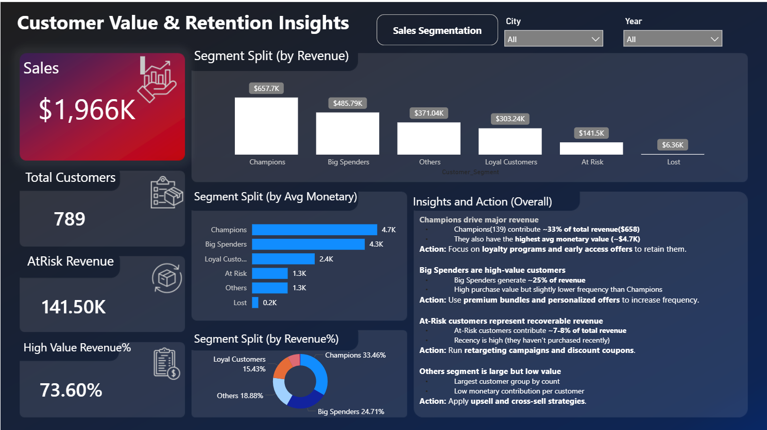
Revenue Contribution & Retention Risk

Slide 6
Strategic Recommendations
Champions
Loyalty rewards Strategic Recommendations
Early access offers
Premium membership programs
Big Spenders
Bundled offers
Cross-selling
Increase purchase frequency
At Risk
Re-engagement campaigns
Personalized discount coupons
Email reminders
Others
Upselling strategy
Targeted promotions

